Slide 1


Slide 2

Revolutionizing Makhana Cultivation with Modern Technology "Leveraging Science and Technology for a Sustainable Future"
Presented By:
Harsh Kumar & Utpal Kumar
Department of Economics

Slide 3
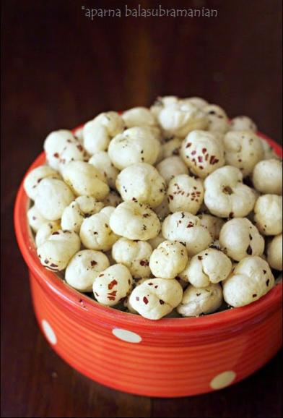
Introduction
"Makhana, also known as fox nuts or lotus seeds, are the edible seeds. They are a type of water lily plants. These small, round seeds are typically puffed or roasted before consumption.
Traditional cultivation is labor-intensive and inefficient.
Recent advancements, such as “IoT sensors”, “Mechanized weed removal”, and solar dryer, improve efficiency and sustainability
Bihar Economy Boost
This Photo by Unknown Author is licensed under CC BY-NC-ND

Slide 4
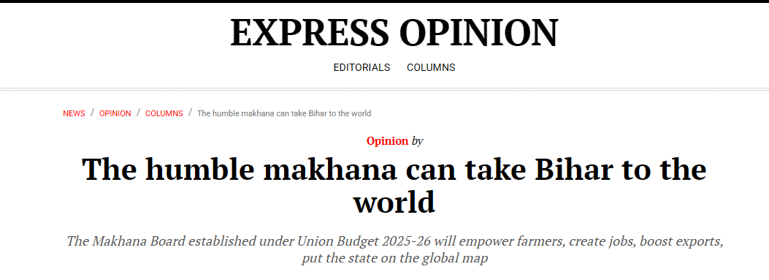

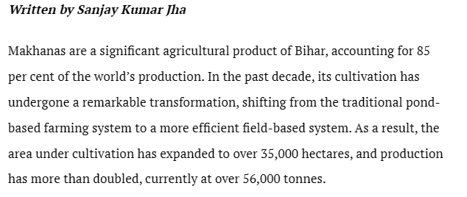

Slide 5

Challenges in Traditional Makhana Cultivation
Key Problems Farmers Face
Labor-Intensive Harvesting:
Farmers manually collect seeds from ponds, which is time-consuming and physically demanding.
High Water Usage:
Large-scale cultivation requires a continuous water supply, leading to wastage.
Low Yield & Inefficiency:
Lack of scientific farming techniques results in low production per hectare.
Long Drying Process:
Traditional sun-drying is slow, unhygienic, and weather-dependent.

Slide 6
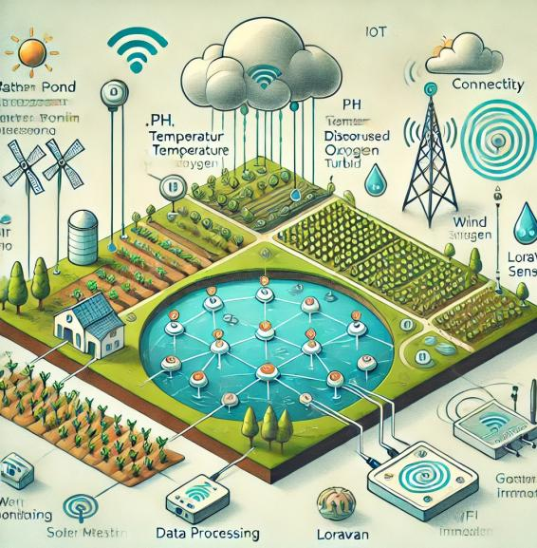
Smart Farming: The Role of IoT Sensors
What is IoT in Agriculture?
IoT (Internet of Things) is a system in which connected devices collect and analyze real-time data.
How Does IoT Help in Makhana Farming?
Water Quality Monitoring:
Sensors track temperature, pH levels, and nutrient content in ponds.
Automated Data Collection:
Farmers receive real-time alerts on mobile devices about water conditions.
Better Decision-Making:
Helps optimize fertilizer and water use for higher yield.

Slide 7

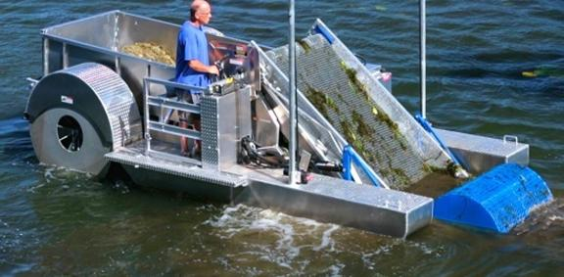
Using Mechanized Tools for Weed- Removal
Traditional Weed- Removal Issues:
Farmers manually remove weeds, which is slow and labor-intensive.
How Mechanized Tools Help?
Faster & More Efficient:
Machines can remove weeds 3x faster than manual labor.
Lower Labor Costs:
Farmers don’t need as many workers, reducing costs.
Health Benefits:
Farmers avoid long hours in the water, reducing the risk of infections.
Example of Modern Tools:
Floating weed-cutting machines
Automated water-cleaning devices

Slide 8
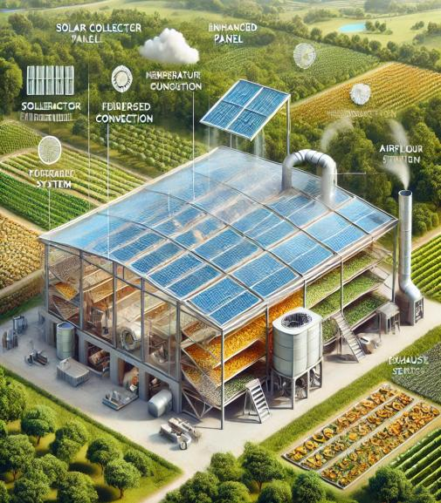
Enhancing Makhana Processing with Solar Drying
Challenges of Traditional Drying:
Farmers use open-air sun drying, which is:
Slow (takes several days).
Unhygienic (exposure to dust, and insects).
Weather-dependent (rain disrupts drying).
How Solar Drying Helps:
Faster drying process (reduces time from days to hours).
Hygienic and controlled environment (no dust, pests).
Eco-friendly and cost-effective (uses renewable solar energy instead of electricity).
Example of Technology Used:
Solar-powered dryers with temperature control.

Slide 9
Water Management & Sustainable Farming
Water Wastage in Traditional Farming:
Makhana farming requires continuous water supply.
Unmanaged water usage leads to the depletion of natural resources.
Modern Sustainable Water Practices:
Water Recycling:
Filtration systems clean and reuse pond water.
Drip Irrigation for Controlled Water Use:
Helps in efficient water distribution.
Rainwater Harvesting for Makhana Ponds:
Collects and stores rainwater, reducing dependency on groundwater.
Benefits:
Conserves water resources.
Reduces farming costs.
Ensures long-term sustainability.

Slide 10
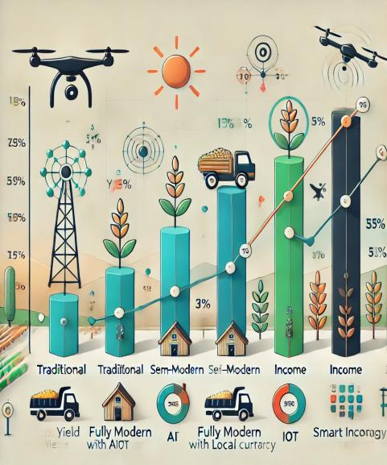
Economic Growth Through Smart Makhana Farming
Higher Yield = More Profit
With IoT monitoring and mechanization, production increases by 30-40%.
Cost Reduction
Lower labor costs due to automation.
Lower energy costs with solar drying systems.
Growing Global Market for Makhana
Demand for organic, healthy snacks is rising.
Indian makhana is exported to the USA, UAE, and Europe.
Increased Rural Employment
More jobs in mechanized farming, processing, and export logistics.
Government Subsidies & Investments
Government schemes support smart agriculture.

Slide 11
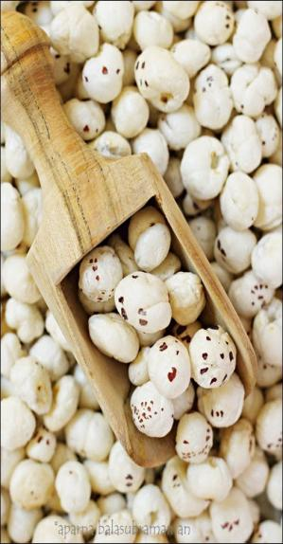

Bihar featured prominently in Finance Minister Nirmala Sitharaman’s Budget speech on Saturday (February 1, 2025) as she announced a slew of schemes for the state. A new Makhana Board, National Institute of Food Technology, Entrepreneurship and Management were announced. Apart from these, greenfield airports will be added in addition to the expansion of Patna airport and the West Kosi canal project in Mithilanchal was also announced.
Union Finance Minister Nirmala Sitharaman while presenting the Union Budget on Saturday (February 1) said that a “Makhana Board” will be set up in Bihar.
“A Makhana Board will be established in [Bihar] to improve production, processing, value addition, and marketing of makhana… The Board will provide hand holding and training support to makhana farmers, and will also work to ensure they receive the benefits of all relevant Government schemes,” the Finance Minister said.
In recent years, the once humble makhana has skyrocketed in popularity around the world as a “superfood” of choice among fitness enthusiasts. This has prompted the government to focus on marketing makhana to commercially harness its popularity.
This Photo by Unknown Author is licensed under CC BY-NC-ND

Slide 12

The market value of Fox nuts-
The company processes about 30 metric tons of water lily seeds per season, but only 40% successfully pop and turn into good-quality foxnuts.
These popped seeds are now worth up to 550 rupees per kg and they will reach 900 rupees in bigger cities like Delhi. And up to 170 dollars per kg abroad.
During 1998, the rate of fox nuts was between Rs 80- 90 per kg. At that time, it was not as popular as it is now. There was no market for foxnuts. It was primarily used for religious purposes. But now, the profit has gone up by 30% as compared to then.

Slide 13
Future Economic Prospects in Makhana Farming
Projected Market Growth
India's makhana market is expected to grow by 10-15% annually.
Increasing global awareness of its nutritional benefits fuels demand.
Role of Government & Private Investment
Government subsidies & incentives for sustainable farming.
Rise in Agri-tech startups promoting IoT-based farming solutions.
Diversification Opportunities
Value-added products: Makhana-based snacks, flavored fox nuts, and makhana protein supplements.
Online platforms (Amazon, Flipkart) enabling direct farmer-to-consumer sales.

Slide 14
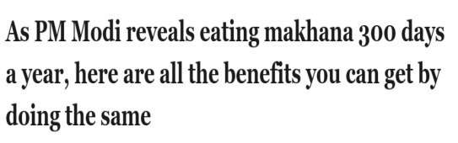

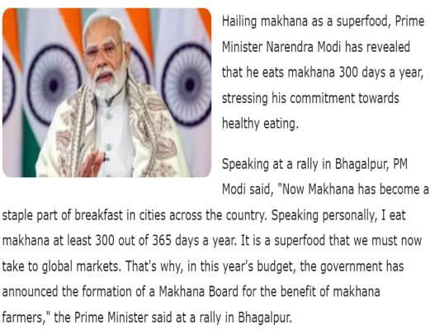
Makhana is a good source of carbohydrates, protein, and minerals. The raw Makhana contains 76.9% carbohydrate, 12.8% moisture, 9.7% protein, 0.9% phosphorous, 0.5% minerals, 0.1% fat, 0.02% calcium, and 0.0014% iron whereas, popped Makhana contains 84.9% carbohydrate, 4% moisture, 9.5% protein and 0.5% fat (Kumar et al., 2011a, 2011b; Shankar et al., 2010; Jha and Prasad, 1990; Boyd, 1968; Jha, 1999; Kumar et al., 2016). It also has nutritional and medicinal value and supports cottage.

Slide 15
Conclusion
Summary of Key Points:
Modern technology is transforming Makhana farming.
With smart irrigation, IoT, and mechanization, productivity has increased.
Water conservation & sustainable practices ensure long-term growth.
Economic benefits include higher profits, better market access, and job creation.
Final Message:
"Technology-driven Makhana farming is the future – ensuring sustainability, profitability, and global recognition."

Slide 16


